Slide 1





Lesson 3:Catch the Bus

Slide 2
Slide

Slide 3
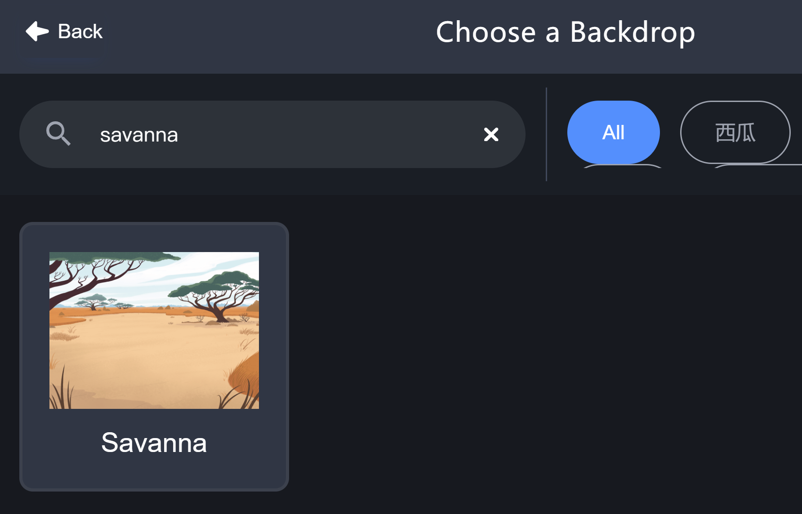
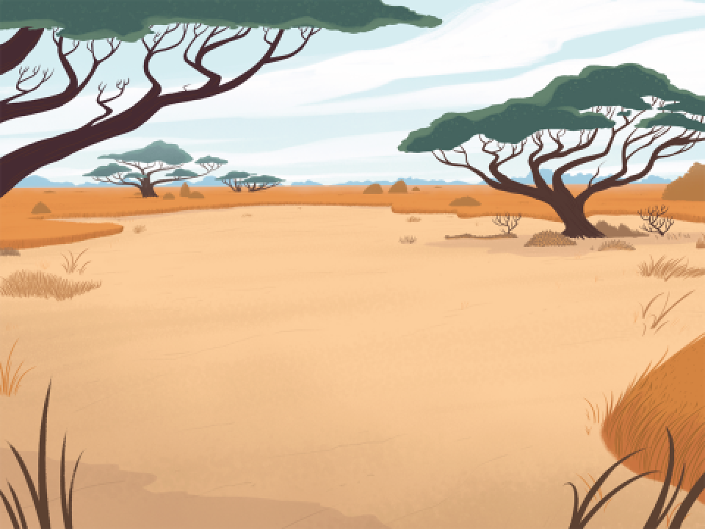
Backdrop - Savanna

Slide 4

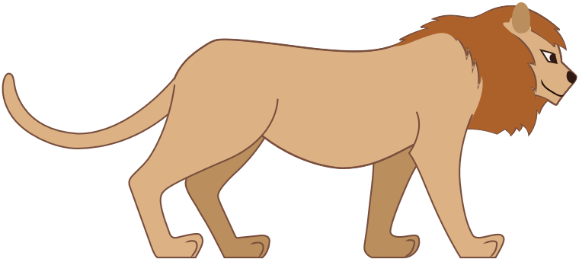

Animal Sprites
Lion
Parrot
Hedgehog

Slide 5
Change Sprite Size
size: 50
size: 100
size: 200

Slide 6
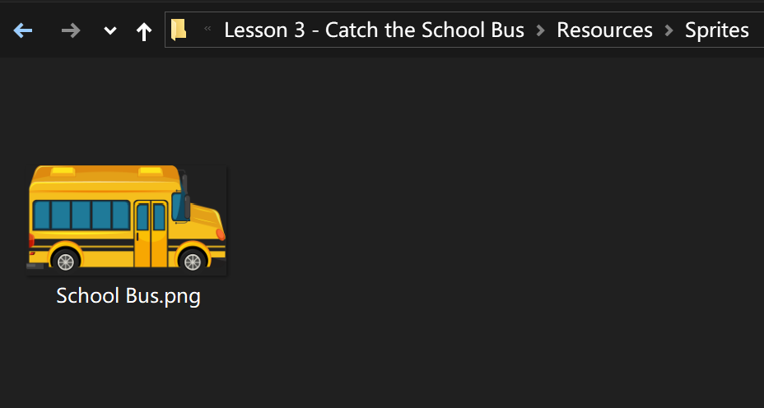

School Bus

Slide 7
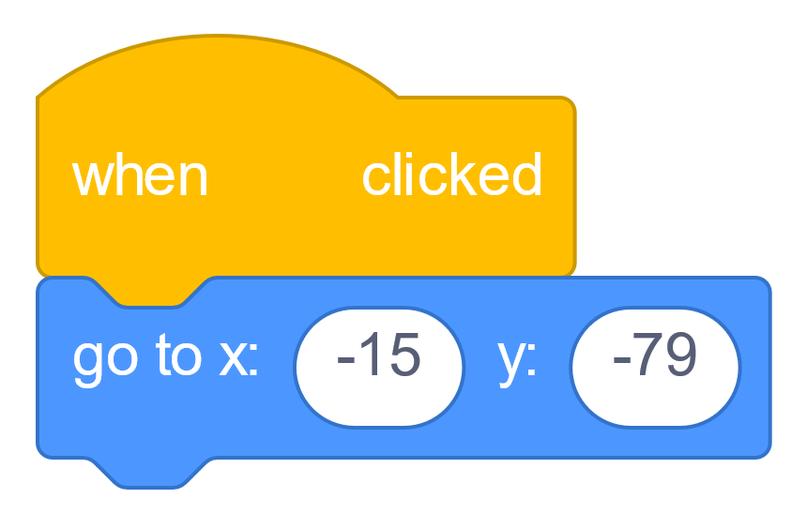
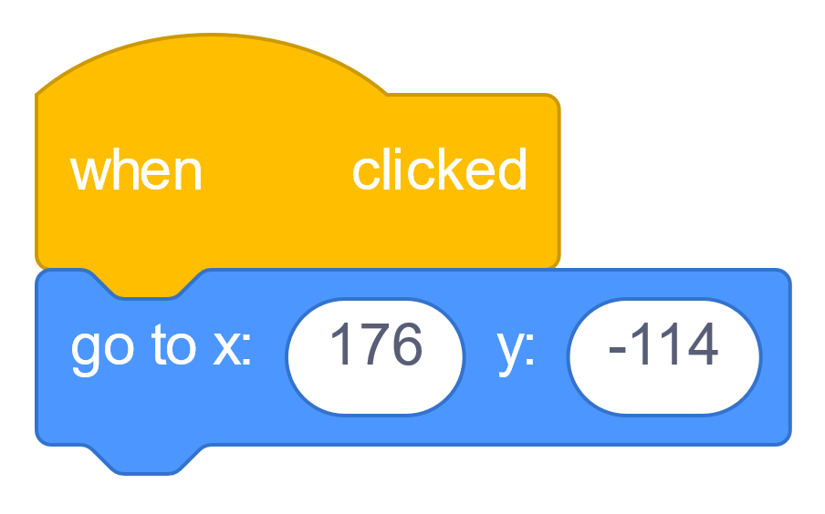

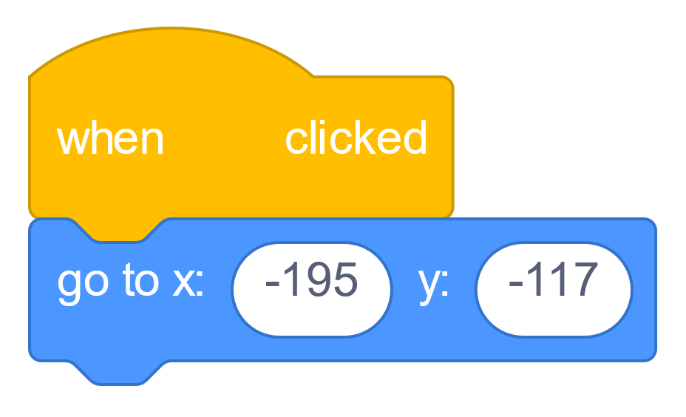
Get in Place!

Slide 8
Not Facing the Bus!

Slide 9
What we learnt…

Slide 10
Exercises
Have fun with some of the other effects
Try different sprites and backdrops
Say and think differently
Checkout costumes of other sprites
Invent your own way of communication!

Slide 11
Thank you and see you in the next lesson!

